Slide 1
Rule ordering and the cycle
Introduction Part II, Kie Zuraw
M100, MIT, Sept. 2023

Slide 2
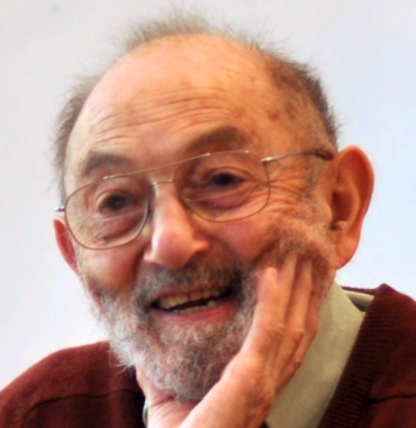
What are rule ordering and the cycle for?
Capturing how processes interact
panibo → panbo → pambo
deletion feeds assimilation
panibo → (no assimilation possible) → panbo
assimilation counterfed by deletion
Enforcing similarity between related words
apólogy → apòlogétic
vs. expected initial secondary stress: *àpologétic, cf. ròdomontáde
Capturing “level”-type differences
párent - parént-al
adding -al pulls stress rightward
párent - párent-ing
adding -ing leaves stress where it was

Slide 3
Some questions that come up in today’s posters…

Slide 4


How free is rule ordering? (capturing how processes interact)
Can rules be ordered within a level? (Milenković)
How are stress rules ordered with respect to segmental rules? (Rusyanov & Rasin)
When must ordering be disjunctive? (Baković & Blumenfeld)
Are some rule orders unstable? (Davis & Flego)
Are two small, ordered rules really simpler than one big rule? (Nelson)
If we combine two small rules into one big rule, can we still distinguish ordering types (feeding, counterfeeding, etc.), and should we want to?

Slide 5
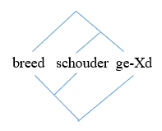
How much do morphology and phonology see each other? (partly: enforcing similarity among related words)
In DM, should there be morpho-phonological rules? (Benz)
When can morphological and phonological structure differ? (van der Hulst)
Is there an inventory of paradigm types that phonology can refer to? (Rebrus, Szigetvári & Törkenczy)

Slide 6
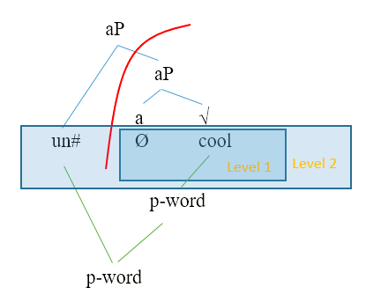
Can we streamline the way we deal with a rule’s domain of application? (“level”-type differences)
Boundary types, levels, prosodic domains, phases…they do a lot of the same work
If we have phases, do we need classical cyclicity? (Newell)
If we have phases, do we need prosodic domains? (Newell)

Slide 7
Capturing how processes interact → How free is rule ordering?
Enforcing similarity between words → How much do morphology and phonology see each other?
Enforcing “level”-type differences → Can we streamline the way we deal with a rule’s domain of application?
To a non-phonologist, or non-linguist cognitive scientist who happened into the room, these might seem like narrow concerns
But they’re not: they’re specific cases of broad-ranging questions about cognition
Let me try to bring some of these questions to mind before you visit the posters
(in a very general way, without getting into the literature, in phonology or in cognitive science, that has explored these ideas)

Slide 8
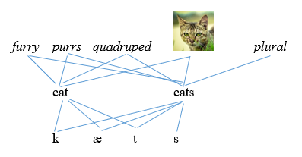
Linked representations
How are mental representations implemented
Which mental representations are linked, how strongly, and why?
Word representations are naturally linked via shared form and meaning
https://commons.wikimedia.org/wiki/File:Cat_Domestic_(2015;_cropped_2023).jpg

Slide 9
Linked representations ← Paradigms
But is that all there is?
Or are there also structured relationships, with structures that must be learned (as opposed to emergent)?
 | singular | plural
nominative | rosa | rosae
genitive | rosae | rosarum
dative | rosae | rosis
accusative | rosam | rosas
ablative | rosa | rosis
It’s not just to what degree are word representations themselves symbolic vs. gradient…
But also to what degree are relationships among word representations symbolic vs. gradient?

Slide 10
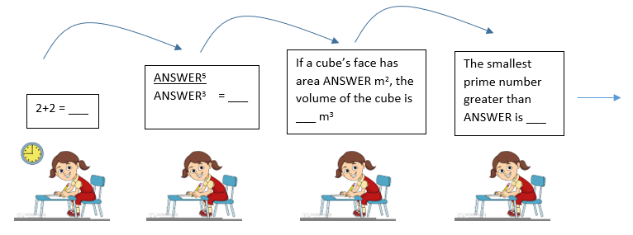
Ordering in cognitive algorithms
Information-dependent ordering
Maybe you’ve participated in a math relay race
You can’t complete your task until you get ANSWER from the person in front of you
(You can often get started, though: possibility for cascading ordering)

Slide 11
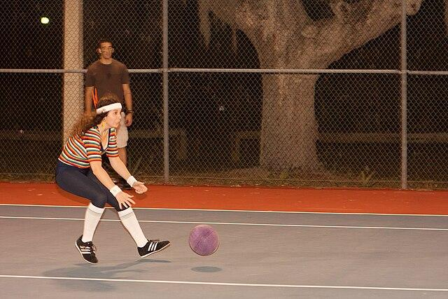
Ordering in algorithms ← How free is rule ordering
Some ordering in cognitive algorithms is necessary because of information dependencies
Catching a ball:
ascertain trajectory ⇒ position hands
You have to know the ball’s trajectory before you can plan (or finish planning) where to put your hands
[There is a huge literature on sports cognition and I’m not well-versed in it, so my specific examples could be wrong!]
Examples in phonology
Before a rule targeting stressed syllables can apply, some stress has to be assigned
stress rules ⇒ stress-dependent rules
You have to know the phonological content of the morphemes you’re dealing with before you can apply phonology to them
some morphology ⇒ some phonology
https://commons.wikimedia.org/wiki/File:Catching_a_utility_ball_in_a_dodgeball_match.jpg

Slide 12
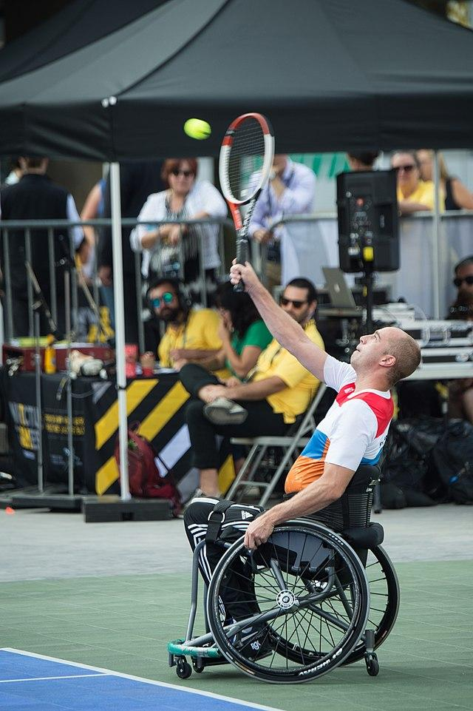
Ordering in algorithms ← How free is rule ordering
Some ordering is necessary in light of a goal
Serving a tennis ball
toss ball in air ⇒ swing racket
goal: hit the ball over net
…so the ball has to be in the air when you swing
…so you have to toss the ball in the air before swinging the racket
You could imagine the reverse order
swing ⇒ toss
perhaps in a dance performance that lacks the “hit-over-the-net” goal
but hard to imagine a sport with this order
Phonology example: If the goal is to avoid place-mismatched sequences like np…
delete potentially intervening material ⇒ place-assimilate
Does phonology have goals (≈ constraints)?
https://commons.wikimedia.org/wiki/File:Team_Netherlands_in_wheelchair_tennis,_serve_(37300128011).jpg

Slide 13

Ordering in algorithms ← How free is rule ordering
Can ordering be arbitrary (must be learned)?
In baseball
hit ball ⇒ run
assuming that hitting and starting to run for first base form a coordinated program
Ordering derives from arbitrary rules of the game
There could be an imaginary sport where you come running from third base to hit the ball at home plate
run ⇒ hit ball
Example in phonology: “Dialect A” vs. “Dialect B” in raising and tapping
/ɹaɪt+ɪŋ/ → ɹʌɪtɪŋ → ɹʌɪɾɪŋ (counterbleeding)
/ɹaɪt+ɪŋ/ → ɹaɪɾɪŋ (bleeding)
https://commons.wikimedia.org/wiki/File:Brown_Batter_Philly_art.JPG

Slide 14
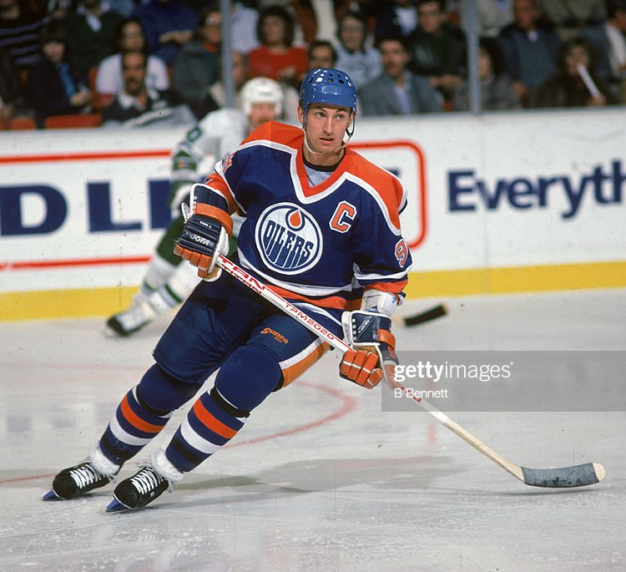
Window of computation ← domain of application
How far into the past and future do you look? What is your buffer size
Wayne Gretzky, supposedly: “I skate to where the puck is going to be”
Phonology examples
How far can the English rhythm rule go? What affects window size?
Imagine a car dealership…
Mìnnesóta àntíque Jàpanése mótorcàrs
→ Mìnnesóta àntíque Jápanèse mótorcàrs
→ Mìnnesóta ántìque Jápanèse mótorcàrs
→ Mínnesòta ántìque Jápanèse mótorcàrs
(I know I said I wouldn’t cite literature here, but see Tilsen 2012, “Utterance preparation and stress clash”)
After a phase domain has been sent to transfer, which computations do we close the book on?
More generally, do domain boundaries of some kind help keep computation under control?
and if that’s their function, does it make predictions?
https://www.gettyimages.com/detail/news-photo/wayne-gretzky-of-the-edmonton-oilers-skates-on-the-ice-news-photo/52067308#/wayne-gretzky-of-the-edmonton-oilers-skates-on-the-ice-during-an-nhl-picture-id52067308

Slide 15
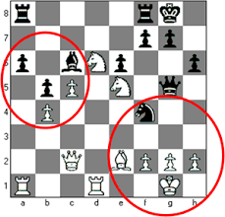
Look-up vs. computation
Not directly addressed in this session, but lurking in proposals about Level 1/stem level
Chess (soccer, etc.) players gain advantage from chunking
recognizing recurring configurations rather than calculating their implications afresh
If phonology and morphology of earlier levels are more likely to be stored, and later levels more likely to be computed (as most think they are)…
How much does that explain why buffer size, opacity, existence of exceptions, etc. work differently in different levels?
Does that view make additional predictions about the differences between levels?
http://billwall.phpwebhosting.com/articles/chunking.htm

Slide 16
It’s time to visit the posters
If you want, you can think about…
Theoretical purpose of rules & cyclicity | Question in today’s posters | Broader issue in cognition
Capturing how processes interact | How free is rule ordering? | Ordering in algorithms: information-dependent, goal-dependent, and arbitrary
Enforcing similarity between words; paradigms | How much do morphology and phonology see each other? | Linked representations: emergent vs. structured
Enforcing “level”-type differences | Can we streamline the way we deal with a rule’s domain of application? | Window of computation Lookup vs. computation

Slide 17
Themes for discussion
1. Can we streamline the way we deal with a rule’s domain of application?
Window of computation
Lookup vs. computation
Boundary types, levels, prosodic domains, phases…they do a lot of the same work
If we have phases, do we need classical cyclicity? (Newell)
If we have phases, do we need prosodic domains? (Newell)

Slide 18
Themes for discussion
2. How free is rule ordering?
Ordering in algorithms: information-dependent, goal-dependent, and arbitrary
Can rules be ordered within a level? (Milenković)
How are stress rules ordered with respect to segmental rules? (Rusyanov & Rasin)
When must ordering be disjunctive? (Baković & Blumenfeld)
Are some rule orders unstable? (Davis & Flego)
Are two small, ordered rules really simpler than one big rule? (Nelson)
If we combine two small rules into one big rule, can we still distinguish ordering types (feeding, counterfeeding, etc.), and should we want to

Slide 19
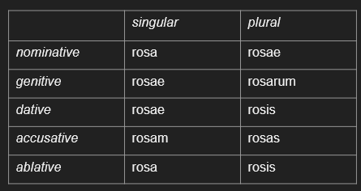
Themes for discussion
3. How (much) do morphology and phonology see each other?
Linked representations: emergent vs. structured
In DM, should there be morpho-phonological rules? (Benz)
When can morphological and phonological structure differ? (van der Hulst)
Is there an inventory of paradigm types that phonology can refer to? (Rebrus, Szigetvári & Törkenczy)

